Slide 1
The Eight Queens algorithm combines recursion and backtracking
Group 2
110378078 賴思潔 111378025 古晶德
111378035 蔡善琪 111378059 阮章硯
111378062 潘勁安 111378066 鍾伊鈞

Slide 2
Abstract
In the Eight Queens Algorithm, we use recursion to recursively place each queen. Specifically, we choose a suitable starting row and recursively process the next row. If we cannot find a suitable position in the current row, we need to backtrack to the previous row and try the next column.

Slide 3
CONTENT
01. Recursive
03. Code explain
02. Backtracking
04. Conclusion

Slide 4
01.
Recursive

Slide 5
What is Recursive
A recursive algorithm is an algorithm which calls itself with "smaller (or simpler)" input values, and which obtains the result for the current input by applying simple operations to the returned value for the smaller input.
More generally if a problem can be solved utilizing solutions to smaller versions of the same problem, and the smaller versions reduce to easily solvable cases, then one can use a recursive algorithm to solve that problem.

Slide 6
Why Do Recursive Methods Work?
Activation Records on the Run-time Stack are the key:
Each time you call a function (any function) you get a new activation record.
Each activation record contains a copy of all local variables and parameters for that invocation.
The activation record remains on the stack until the function returns, then it is destroyed.

Slide 7
Recursive Design
1) One or more base cases that will cause the recursion to end.
if (n == 1) return 1;
2) One or more recursive cases that operate on smaller problems and get you closer to the base case.
return n * factorial(n-1);
Note: The base case(s) should always be checked before the recursive call.
Rule:
Base case - must have a way to end the recursion
Recursive call - must change at least one of the parameters and make progress towards the base case

Slide 8
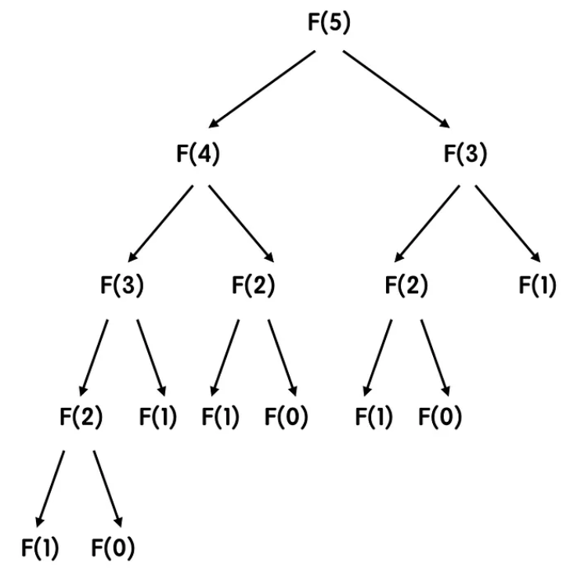
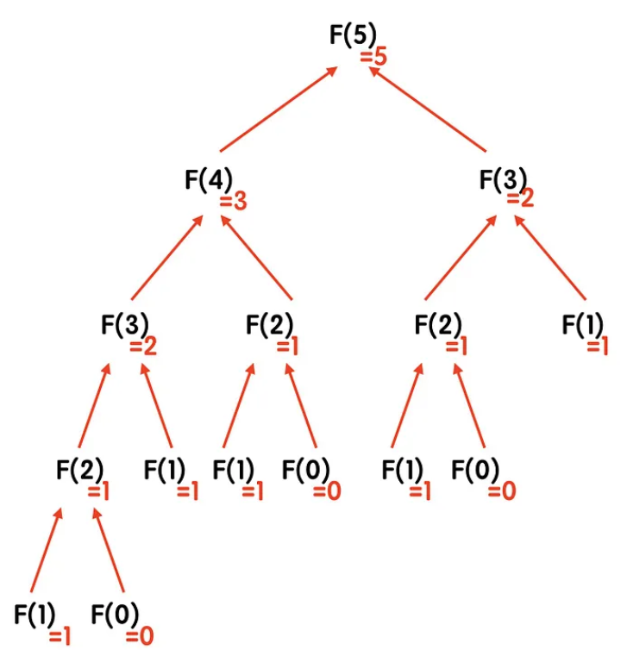
Example : Fibonacci
Every call of the function will stop at F(1) or F(0) at the end, because these two items are the only ones that are defined first, F(1) & F(0) is the “base case” of Fibonacci, which is the timing to stop . Therefore, after finding these two items, you can start summing up the values ​​of other items forward
F(0) = 0
F(1) = 1
F(n ) = F( n-1 ) + F( n-2 )
decomposition
composition
Every time you go to the next level, the number of steps becomes 2 times
There are n layers in total (space complexity O(n))
Time complexity: O(2^n)
Notes:
最簡單理解時間複雜度的方法就是直接使用觀察法。從上面的圖我們可以看到，每往下一層，每一項需要呼叫的次數就變成 2 倍，像 F(5) 要呼叫 F(4) + F(3) 、F(3) 要呼叫 F(2) + F(1) 等等。
而要找到數列的第 5 個數，我們需要的層數是剛好是 5 層，而推展到第 n 個數時，我們剛好需要 n 層。這個部分如果有點抽象的話，可以直接觀察上面的例子，圖中每一層的最左邊那項，是從 F(n) 一路遞減到 F(1)，這樣剛剛好會是 n 層。

Slide 9
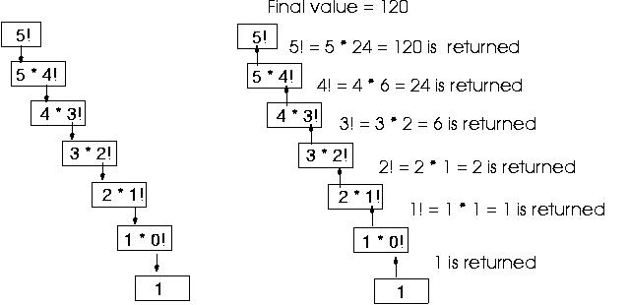
Example : Factorial
1 if n = 0
n!= (recursive solution)
(n-1)!*n if n > 0

Slide 10
02.
Backtracking

Slide 11
What is Backtracking
The backtracking algorithm is a recursive algorithm for solving search and permutation problems.
It follows a depth-first search strategy, gradually building solutions, and backtracking to the previous state when an invalid solution is encountered, before continuing to explore other possible solutions.

Slide 12
Steps in Backtracking
Choose an initial state.
For the current state, generate all possible next states.
Check whether the next state meets the constraints of the problem.
If eligible, add the next state to the solution and continue exploring the next state.
If the condition is not met, backtrack to the previous state and continue to try other possible states.
Repeat steps 4 and 5 until a valid solution is found or all possible states are traversed.

Slide 13
Features of Backtracking
It is suitable for cases where the solution space of the problem is small.
Follow the depth-first search strategy to continuously explore deeper solution space.
The search can be terminated early, when certain conditions are met or invalid solutions are found.
Reasonable design of state transitions and constraints is required to avoid invalid searches.

Slide 14
Backtracking application
Combinatorial optimization problem：TSP、0/1 Knapsack Problem
Graphical and Structural Issues：N-Queens Problem
String handling issues：String Matching Problem、Permutations

Slide 15
03.
Code explain

Slide 16
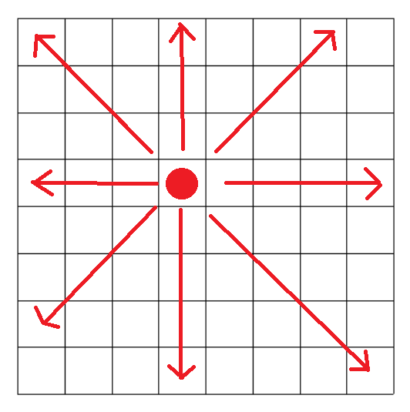
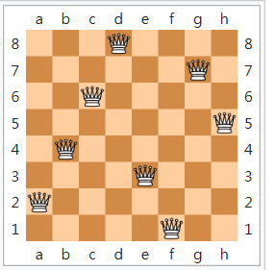
Issues - N queens problem
Introduction : As shown in the figure, assuming that the red dot represents the queen, then the queen cannot be placed in the same row, column, or diagonal line extending from the point.

Slide 17
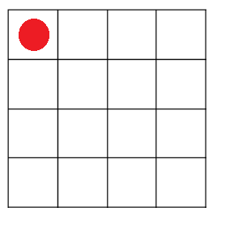
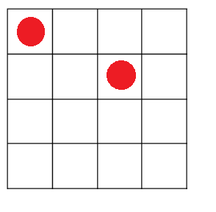
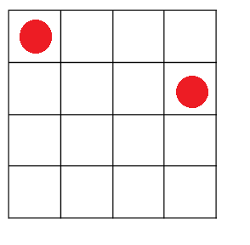
Logical explanation
Index(0)
Suppose we have placed a queen at index0 of the first column
Then deduct the "attack range", the index that can be placed in the second column is only 2 and 3

Slide 18
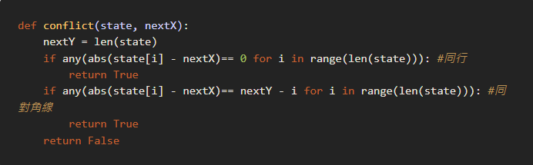
Example - N queens problem
Note.
This is simplified later as the final code, here is for the convenience of explaining the logic
If the two sets of (x, y) coordinates are on the same diagonal,the difference between the
absolute values ​​of the x coordinates = the difference between the absolute values ​​of the y coordinates.
Our logic judges two things:
returns True if the new queen is on the same row as any old queen
returns True if the new queen is on the same diagonal as any old queen

Slide 19
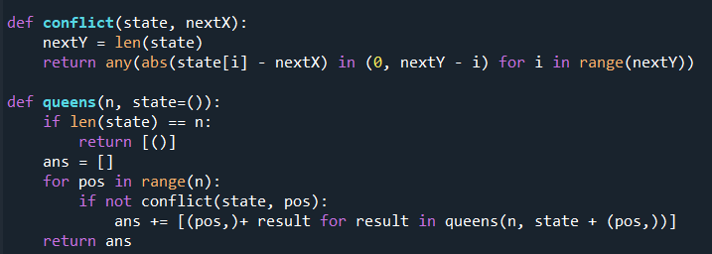
Complete code
Use two defind to complete
We define such a function
conflict(state, nextX), returns True if the new queen is within attack range of any placed queens.
The length of the calculated state is n, and a matrix of 1*n is created.
Loop :
If the pos point is not on the collision point, place the queen (ans) .

Slide 20
Output explain
We set n to 4, which means that the answer is a random set of 1*4 matrix
0 means no queen is put and 1 means there is a queen
There are two groups of places to represent the queen: The position of the first column index 1 The position of index 3 in the second column The position of index 0 in the third column The position of index 2 in the fourth column
0 | 1 | 0 | 0
0 | 0 | 0 | 1
1 | 0 | 0 | 0
0 | 0 | 1 | 0
The position of index 2 in the first column The position of index 0 in the second column The position of index 3 in the third column The position of index 1 in the fourth column
index 0 1 2 3

Slide 21
04.
Conclusion

Slide 22
Conclusion
In conclusion, the combination of recursion and backtracking in the Eight Queens Algorithm provides an effective approach to solving the Eight Queens Problem. This technique allows for a systematic exploration of all possible queen arrangements while ensuring that they meet the problem's constraints.
By leveraging recursion to recursively place queens and backtracking to explore alternative options, the algorithm can find all valid solutions or determine if the problem has no solution.

Slide 23
THANKS!

